Slide 1
How to Learn English Efficiently

Slide 2
Disclaimer
I DO NOT MAJOR IN ENGLISH!
I DO NOT WORK FOR ENGLISH DEPARTMENT!
MY UNDERGRADE ENGLISH IS ONLY ABOVE THE AVERAGE!
This presentation content is based on
  my personal experience in English learning – especially after studying abroad

Slide 3
Define “Good English”
The ability to communicate with others through English
  by reading
  by writing
  by listening
  by speaking
It has nothing to do with English tests!
  Getting good grades from English tests is merely a by-product!

Slide 4
Is Good English Important?
For Individual
  Reading – lifelong learning to improve your competiveness, especially when you want to acquire the most up-to-date knowledge
  Writing – emails with foreign friends/co-workers/customers
  Listening – Q/A with foreign customers/boss/etc
  Speaking – presentation in front of foreign customers/boss/etc, traveling abroad
At University level
  Internationalization is one of the most prioritized tasks

Slide 5
However, We Have Struggled learning English
All of us start learning English at least since our junior high school, so why do you still come here?
Issues
  Lack good environment?
  Bad English teachers?
  Too many exams to ruin your appetite?

Slide 6
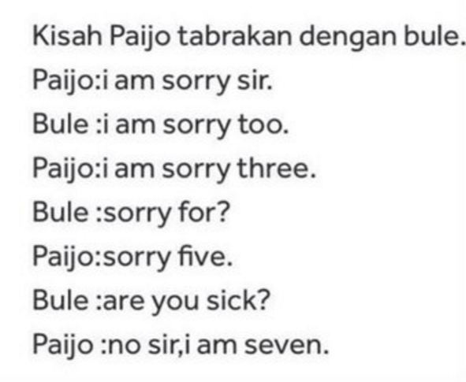
Perseverance is The Key
Courtesy
to

Slide 7
How to be Persevere in English Learning
Do not set the bar too high
  Times, Newsweek Magazines
English learning through Recreation (Fun)
  Playing English games (may not applicable anymore)
  Attending social events
  Travelling
  Listening to music and Karaoke
  Etc…

Slide 8
English Reading
Check your English vocabulary size @ http://www.insightin.com/test/test.phtml
  You need about 10000 to score high in TOEFL/GRE/GMAT
  The average vocabulary size of a 4-year college native speaker is 20000
  You need about 3000 ~ 5000 words to start with
Basic English vocabulary
  http://en.wikipedia.org/wiki/Vocabulary

Slide 9
Start with What?
Using English to learn English
  Read English textbooks
  Play English online games
  Browse interesting English websites daily
    http://espn.com/ (Sports News)
    http://imdb.com/ (Movie Database)
    http://www.eonline.com/ (E! Entertainment News)
    http://www.billboard.com/ (Top Music Chart)
    http://www.dilbert.com (Dilbert Comic)
    http://www.slagoon.com/ (Sherman’s Lagoon Comic)
    http://www.peanuts.com/ (Snoopy)
    http://bensbargains.net/ (Deal Site)

Slide 10
English Writing
You should have received enough grammar knowledge from your high school English classes
Never trust Google translation
  Better choices out there
    http://www.grammarly.com/
    http://www.grammarcheck.net/
How to improve your writing
  Reading, reading, and more reading
  Spelling and grammar check tools are your best friends
  Imitate Good Sentences
Write English emails (and do it w/ care) daily/often to
  International Pen Pals
    http://www.interpals.net/
  Your professors/advisors (and ask them to correct your grammar whenever there is a mistake)

Slide 11
How About English Listening/Speaking?
The Most Difficult Parts in English Because
  No Environment!
Suggestions
  Don’t be shy to speak!
  Take courses taught in English
  Get to know some “language partners” (there are quite a few international students at UNAIR)
  Speak in front of people in English (for presentations, group meetings, TA sessions)
  <= This will make a huge difference

Slide 12
Differences Between English Writing and Speaking
In English writing, we sometimes use sentences with complex structure
  I recommend against complex sentences, unless you can not avoid that
In English speaking, NEVER use complex sentences
  No native speaker do that, either

Slide 13
Other Things You Should Try
Listen to English songs
  Do not learn from Rap songs (Ebonics)
  Practice singing English songs (KTV is a good place)
Correct yourself whenever you hear something wrong in your own speech
  Phase 1 – You are too nervous to even hear your own voice (ask others to correct you)
  Phase 2 – Correct yourself (mostly grammar mistakes)
  Phase 3 – Improve your pronunciation (tools like audacity help)

Slide 14
English Pronunciation
Resources
https://www.real-english.com/reo/42/42-6.htm
http://learnenglish.britishcouncil.org/en

Slide 15
Intonation Makes a Big Difference
Lack of intonation
- English Javanese?
  Mandarin: fixed tones and rhythm
  English: variable pitch and tempo
Where can we learn the correct intonation?
  English songs
  Watch movies (with and w/o caption)
    A highly recommended movie: Forrest Gump

Slide 16


